Slide 1

20 years in music.
2000 - 2019
Predict some popularity by team Project 002
Data Analysis Bootcamp - Rice University - 2022

Slide 2







Project 002 Team
Aktug Cilekci - Square Role
Robby Rangel - Triangle Role
Julian Flores - Circle Role

Slide 3
Topic Selection
Music has been an integral part of our culture all throughout human history.
The U.S. music industry generated $29 billion in 2021.
The majority of the revenue is generated by popular, mainstream songs.
Therefore the team selected this topic, because:
Having a fundamental understanding of what makes a song popular has major implications to businesses that thrive on popular music, namely radio stations, record labels, and digital and physical music marketplaces.

Slide 4
Description of Data Source
We used music data from Top Hits Spotify from 2000-19 The dataset is an exhaustive collection of audio features and metadata for over 2000 songs . The audio features include attributes about the music track itself, such as duration, key, year. The metadata uses more abstract features,such as danceability,energy,or song popularity .We extracted 2,000 songs from the database.We divided these songs so that 80% of the songs was used for training and 20% was used for testing.Below is a subset of the fields for a song in the dataset.
Feature | Type | Description
Key | Int | The key the trach is in
Loudness | Float | Overall loudness in dB
Mode | Int | Major or Minor
Genre | object | Genre of tracc

Slide 5
The Goal
Our goal is to create a machine learning model that can predict a song’s popularity.

Slide 6
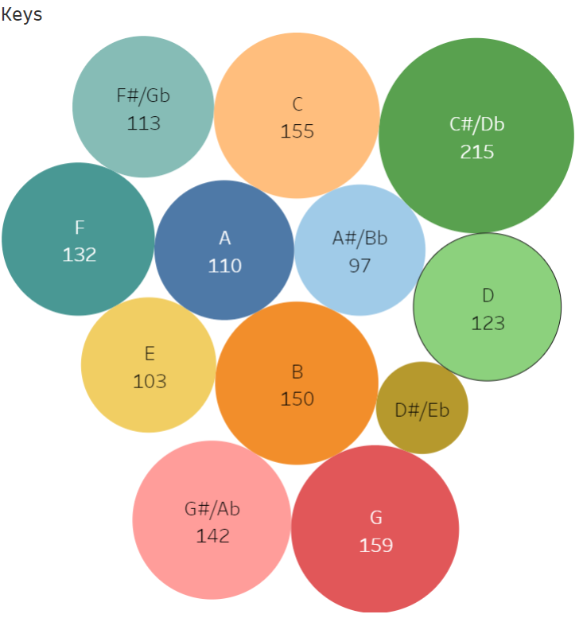
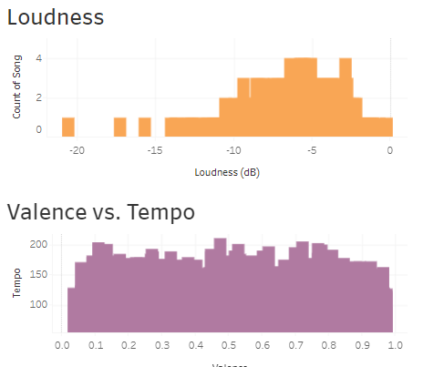
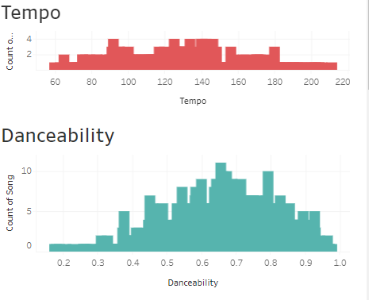
Dashboard
Dashboard link https://public.tableau.com/app/profile/rarangel/viz/Project_Team_2_Dashboard/Dashboard?publish=yes

Slide 7
Data Exploration
Extract, transform and load:
Two datasets were extract from Kaggle.com .
The datasets were merged by using sql inner join query.
The dataset was uploaded to notebook by engine via PostGresSql server.
Exploratory Data Analysis:
Display Data Types.
Determine if there is any Null or Missing Values
Display Summary of Statistics
Creating Visualization:
Popularity Density Plot with Seaborn.
Range and Distribution Plots for numerical features.
Multivariate Analysis.
Histogram Plots for each feature
Correlation Heatmap.
Creating categorical column for ‘popularity’ by qcut function. Below the mean popularity will be 0 and above the mean popularity will be 1.
Convert binary column ‘explicit’ to numerical data type.
Export the processed dataset to sql table with PostGres server.

Slide 8
The Analysis
Feature Extraction
Baseline Features : Features from the DataSet
Additional Features : Generated by OneHotEncoder
Bucketing : Used frequency plots to bucket frequently occurring words
Feature Selection :
Cross Validation.
Correlation Heatmap .
Machine learning Models
Neural Network.
Random Forest Classifier.
Logistic Regression .

